Slide 1


Health Insurance Analysis
DATA SCIENCE EXAM PRESENTATION
Ahlam Labiad
Oluwatobi Fakoya
Abdulwasiu Tiamiyu
SUPERVISED BY
Pr. Ikram CHAIRI
Bochra CHEMAM

Slide 2
Outline
Introduction
Dataset
Source
Dictionary
Data Description
Data Cleaning and Preprocessing
Feature Engineering
Data Exploration and Visualization
Univariate Analysis
Bivariate Analysis
Multivariate Analysis
Hypothesis Testing
Key Findings
Future Work

Slide 3
Introduction
Health insurance or medical insurance is an agreement where an insurance company agrees to compensate the insured for the medical and surgical expenses incurred during the policy tenure. The medical expenses may incur if the insured falls ill, or meets an accident that leads to hospitalisation of the insured.
To be eligible to avail coverage benefits under the policy, the policyholder is required to pay a specific amount periodically, known as premium.
Health Insurance premium is decided by an insurance company and policyholders are required to pay the same on a monthly, quarterly, half-yearly, or yearly basis, without any lapse, to avoid losing the renewal benefits.

Slide 4
Introduction
Data analysis is defined as a process of cleaning, transforming, and modeling data to discover useful information for business decision-making. The purpose of Data Analysis is to extract useful information from data and taking the decision based upon the data analysis.
PROBLEM STATEMENT: In this project, we will be using visualizations and statistical hypothesis testing to evaluate and examine a dataset for medical costs in Health Insurance in the United States, in order to draw significant insights and make some statistical-based inferences.

Slide 5
Dataset
Data Source: US Health Insurance Dataset
Insurance Premium Charges in US with important details for risk underwriting.
Data Dictionary:
Age: age of primary beneficiary
Sex: insurance contractor gender, female, male
BMI: Body mass index (BMI) is a value calculated by dividing a person's weight in kilograms by the square of height in meters.
Children: Number of children covered by health insurance / Number of dependents
Smoker: Smoking
Region: the beneficiary's residential area in the US, northeast, southeast, southwest, northwest.
Charges: Individual medical costs billed by health insurance.

Slide 6
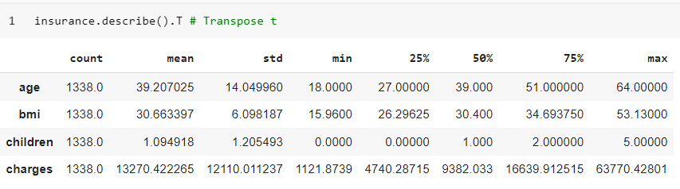
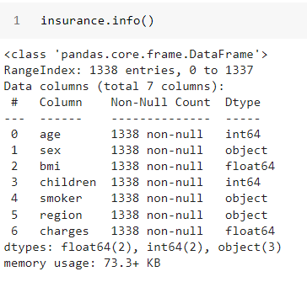
Data Description
The data set has 1338 entries with 7 attributes. 2 integer type, 2 float type and 3 object type (Strings in the column).
There are no null values in any of the columns.
The data statistics generally looks in good shape.
The data in the age column represents true age distribution of the adult population.
The charged amount is highly skewed as most people would require basic medical care and only few suffer from diseases which cost more to treat.

Slide 7
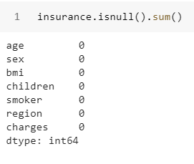
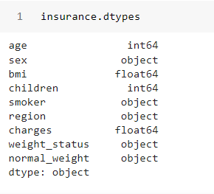
Data Cleaning and Preprocessing
The variable names are well written and convey actual meanings.
There are no missing values in the data.
The columns are in the right data types.

Slide 8
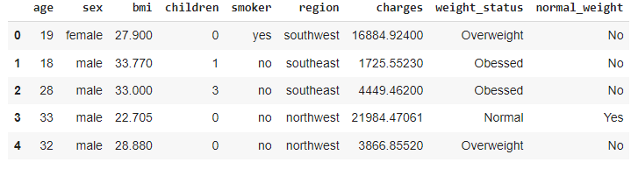
Feature Engineering
Body mass index (BMI) is a value derived from the mass (weight) and height of a person. ( A person's weight in kilograms divided by the square of height in meters. )
The BMI is used by healthcare professionals to screen for overweight and obese individuals.
The BMI is used to assess a person’s health risks associated with obesity and overweight.
For example those with a high BMI are at risk of: high blood cholesterol or other lipid disorders, type 2 diabetes, heart disease, stroke, high blood pressure, etc…
BMI | Weight Status
Below 18.5 | Underweight
18.5 - 24.9 | Normal
25.0 - 29.9 | Overweight
30.0 + | Obesity

Slide 9
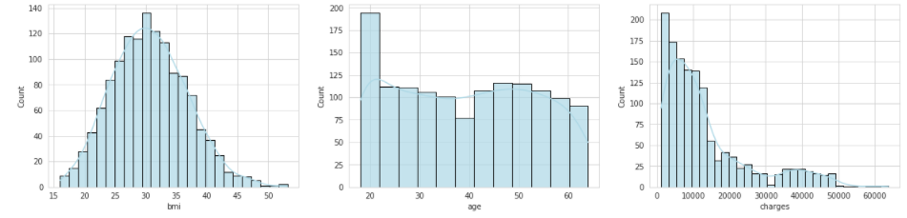
Data Exploration and Visualization - Univariate Analysis
The BMI is normally distributed.
The age seems to assume a uniform distribution with hardly no skewness.
Charged amount variable is rightly skewed (positive skewness).

Slide 10
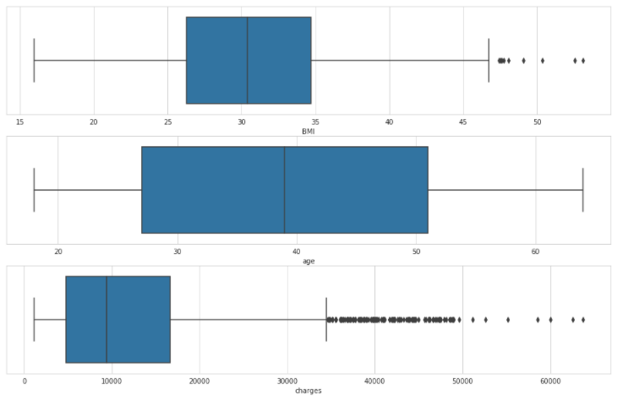
Data Exploration and Visualization - Univariate Analysis
The BMI has a few extreme values.
The age has no extreme value.
The charged amount is highly skewed, there are quite a lot of extreme values.

Slide 11
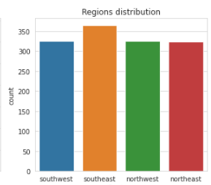
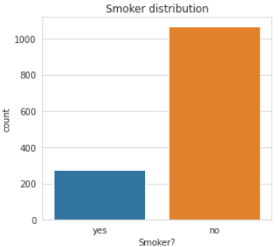
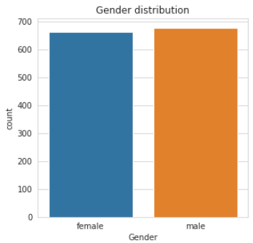
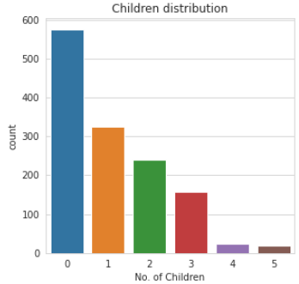
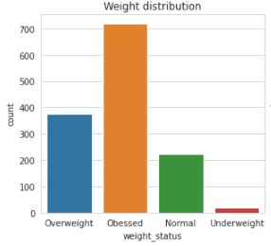
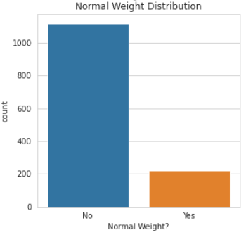
Data Exploration and Visualization - Univariate Analysis

Slide 12
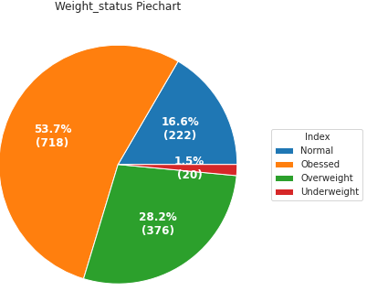
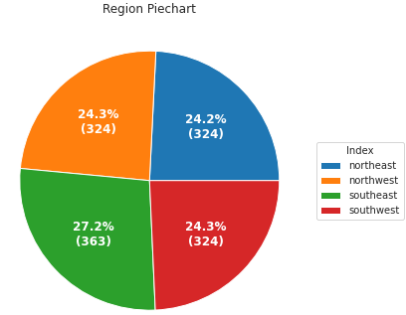
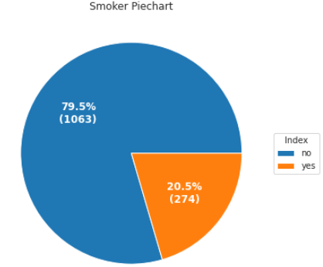
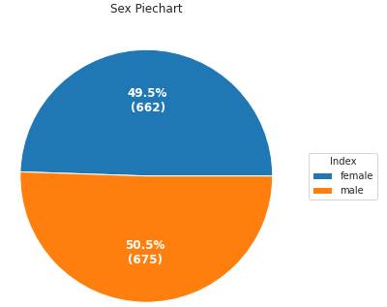
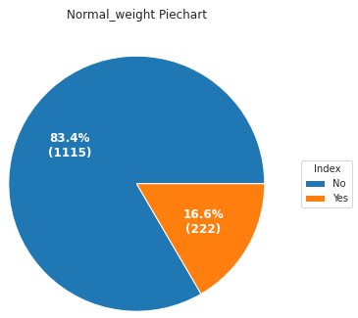
Data Exploration and Visualization - Univariate Analysis

Slide 13
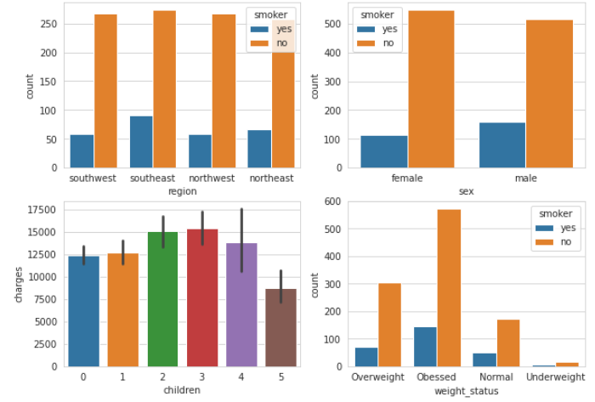
Data Exploration and Visualization - Bivariate Analysis
Smoking habits of people of different regions are similar.
There are many more male smokers than female.
Obese individuals smoke the most, followed by the overweight.
Approximately 85% (1138 / 1338) of the insured have less than 3 children.

Slide 14
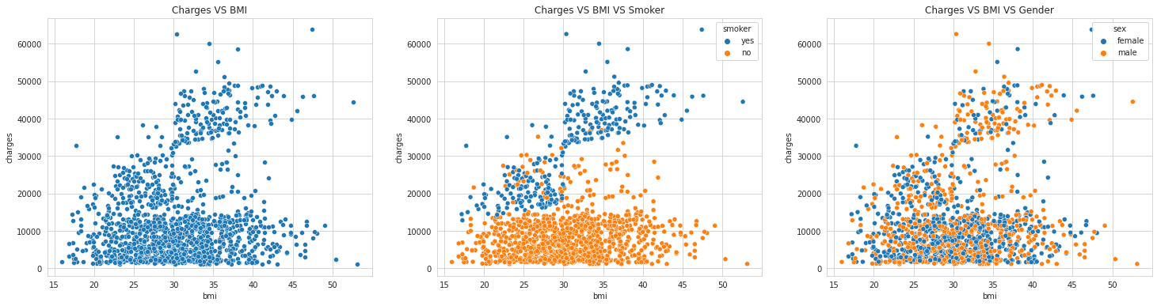
Data Exploration and Visualization - Bi/Multivariate Analysis

Slide 15
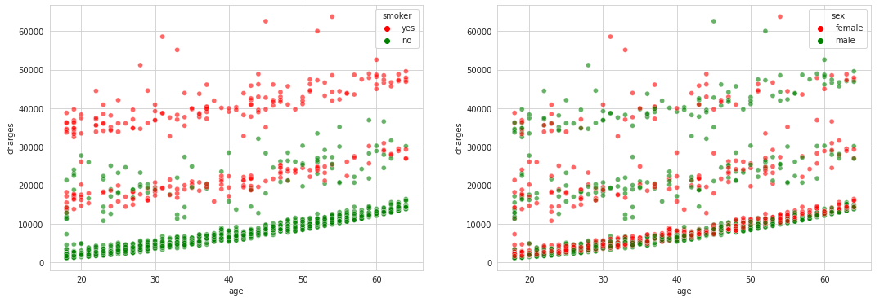
Data Exploration and Visualization - Multivariate Analysis
Apparently, the non smokers’ charged amounts seem smaller than those of the smokers.
Obviously, both genders seem to be charged even amounts across the age distribution.

Slide 16
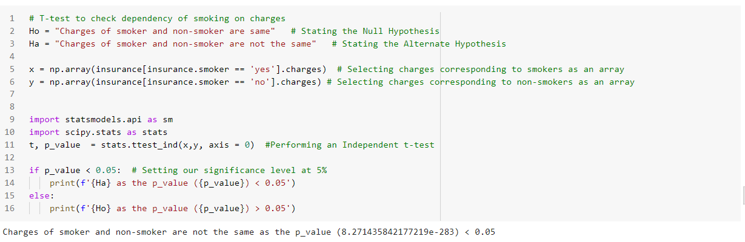
Hypothesis Testing (Student T-Test)
H0: Charges of smokers and non-smokers are the same
H1: Charges of smokers and non-smokers are not the same
Charges of people who smoke differ significantly from the people who don't. so we reject the null hypothesis.

Slide 17
Key Findings
Smoking significantly influences the charged amounts: Smokers are charged more than non-smokers.
The BMI is evenly distributed across males and females.
The amount of male smokers is higher than female smokers.
There is no difference in the amount charged for both genders.
Smoking habits of people of different regions are similar.
The BMI is directly positively correlated to the amounts charged.

Slide 18
Future Work/Recommendation
Predictive Analysis to predict an individual charged amount
Health campaign to sensitize people on the health risk factors associated with smoking and Obesity.
Diets and Exercises that reduce weight should be recommended.

